Slide 1

Final project: Study of an IoT simulator
CS 501: The Internet of Things
Students:
Cicéron Ovide Aissoun -- Ahmad Issa
Dr. Mohammed Ayoub Alaoui Mhamdi
Bishop's University
Sherbrooke, Qc, Canada
malaoui@ubishops.ca

Slide 2
Overview
Open-source simulation tool for IoT and WSN systems
User-friendly graphical interface
Integration with Eclipse IDE

Slide 3
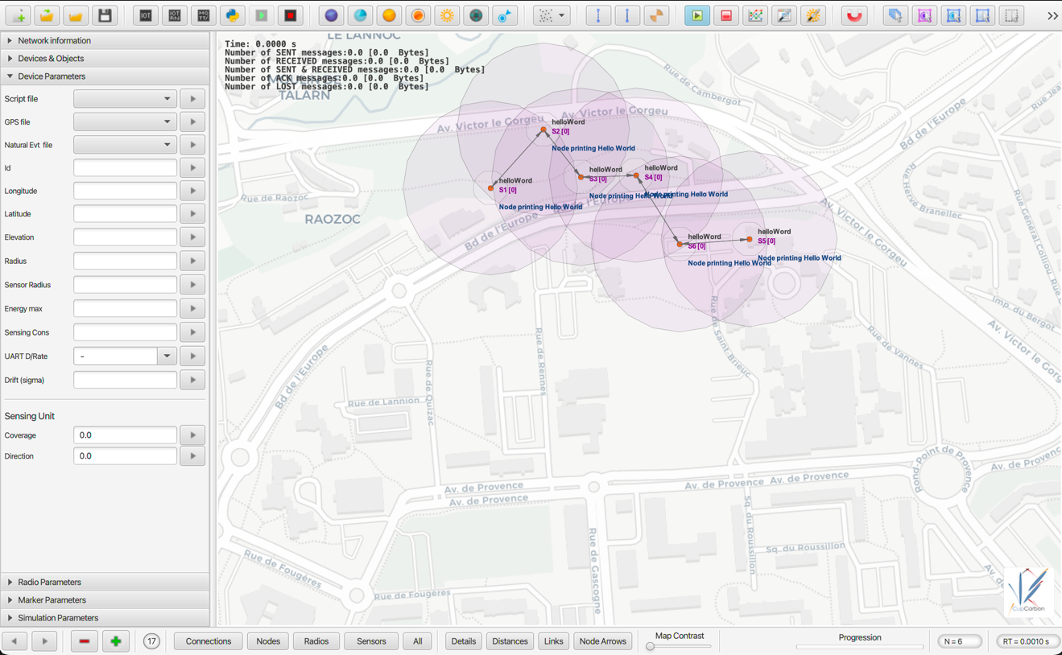
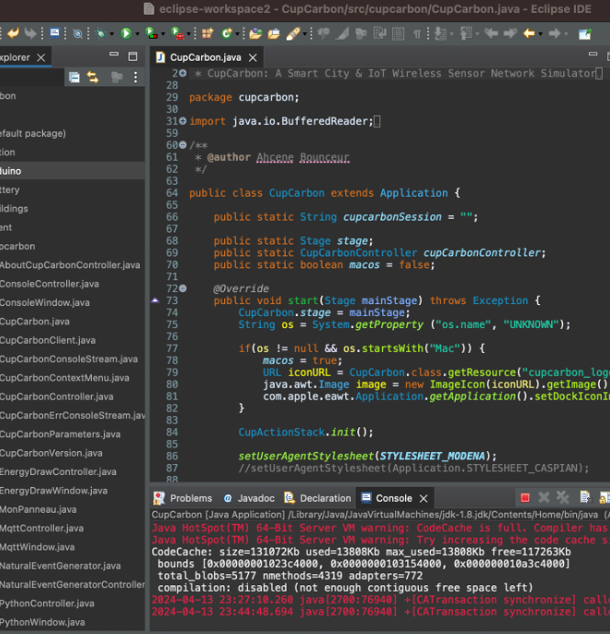
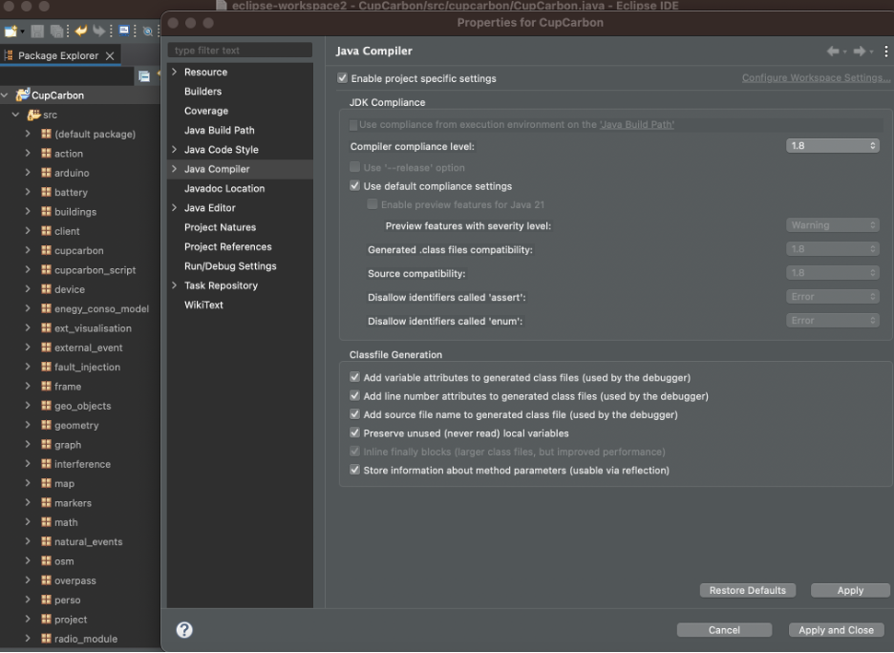
CupCarbon Key Features
Graphical Interface
Simulation Capabilities
Scripting Support
Real-world Maps
Research and Education
Integration with Eclipse

Slide 4
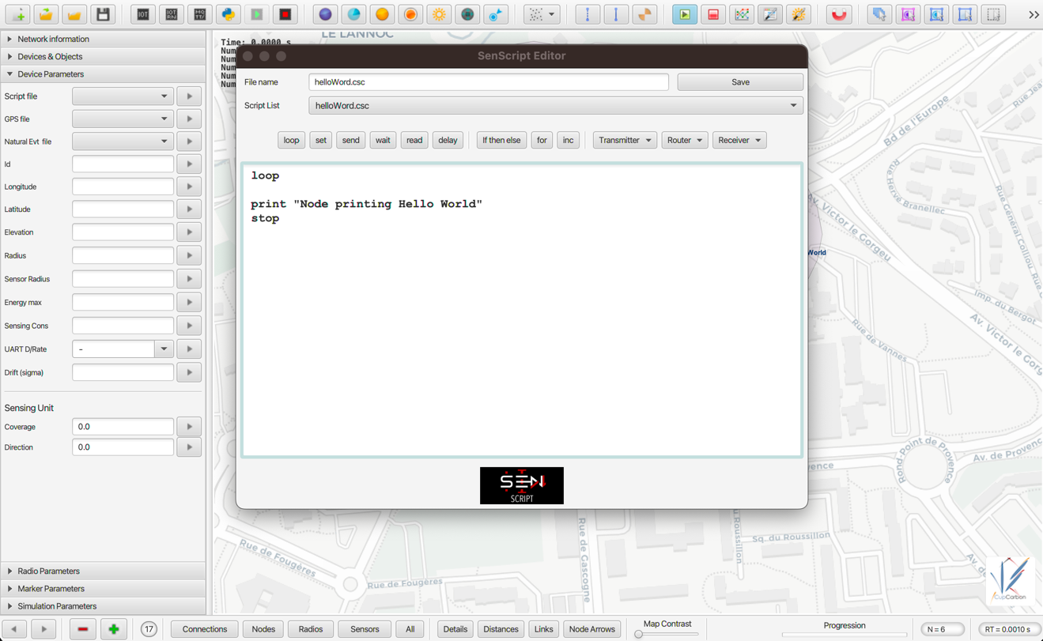
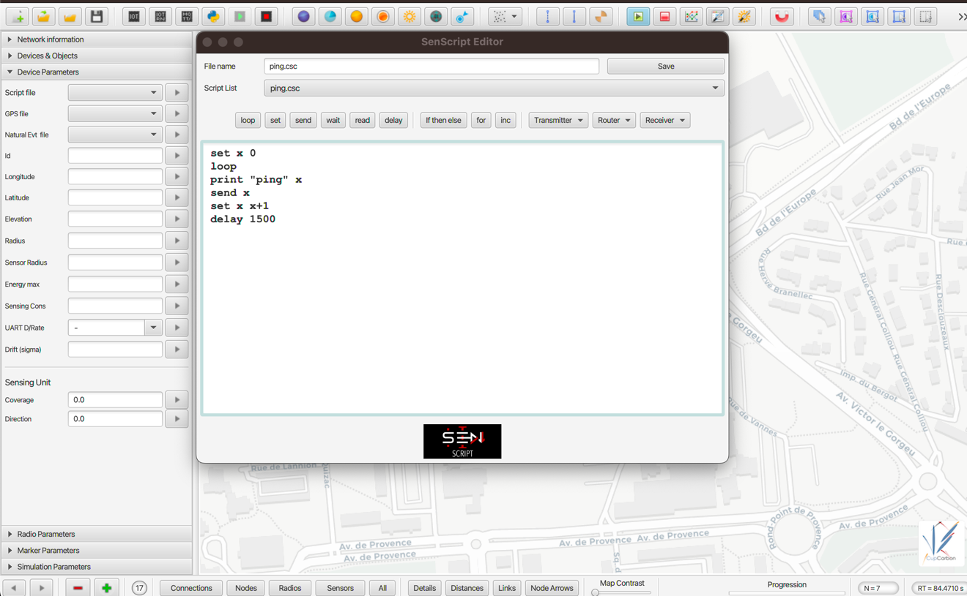
CupCarbon Supported Languages
Java
Scripting Language
Uppaal Stratego

Slide 5
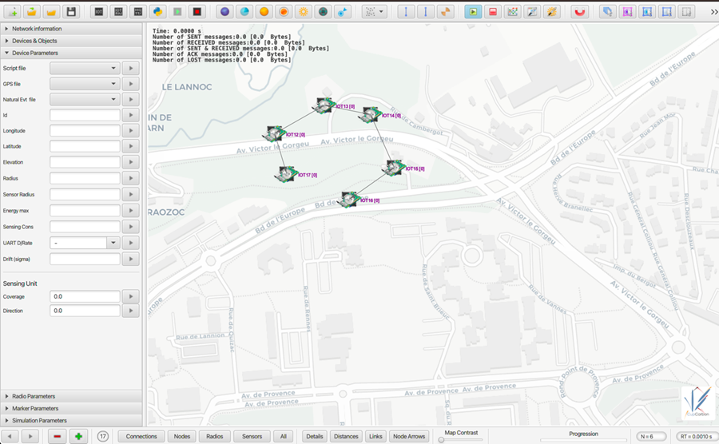
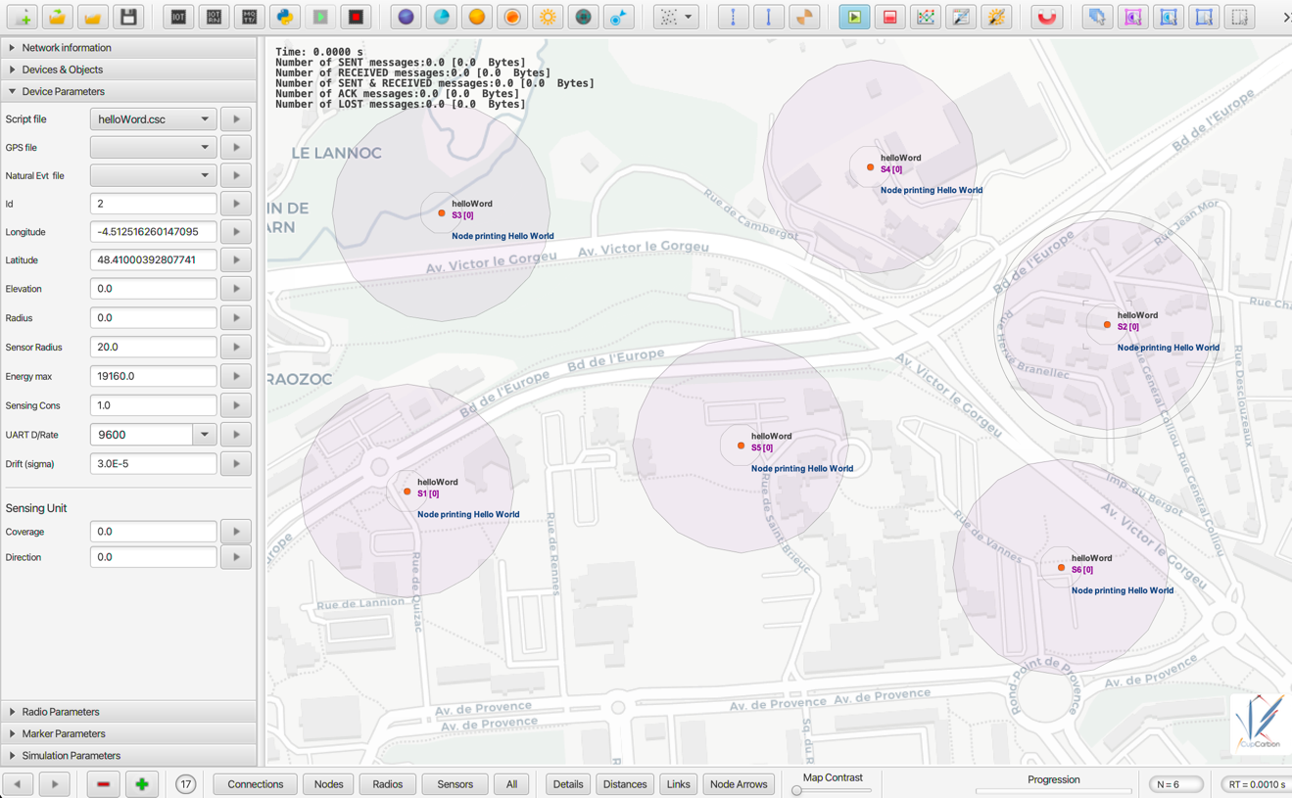
CupCarbon Mote Types
Generic Motes
Specific Protocol Motes
Mobile Motes
Energy-aware Motes
Actuators
Gateway Motes

Slide 6
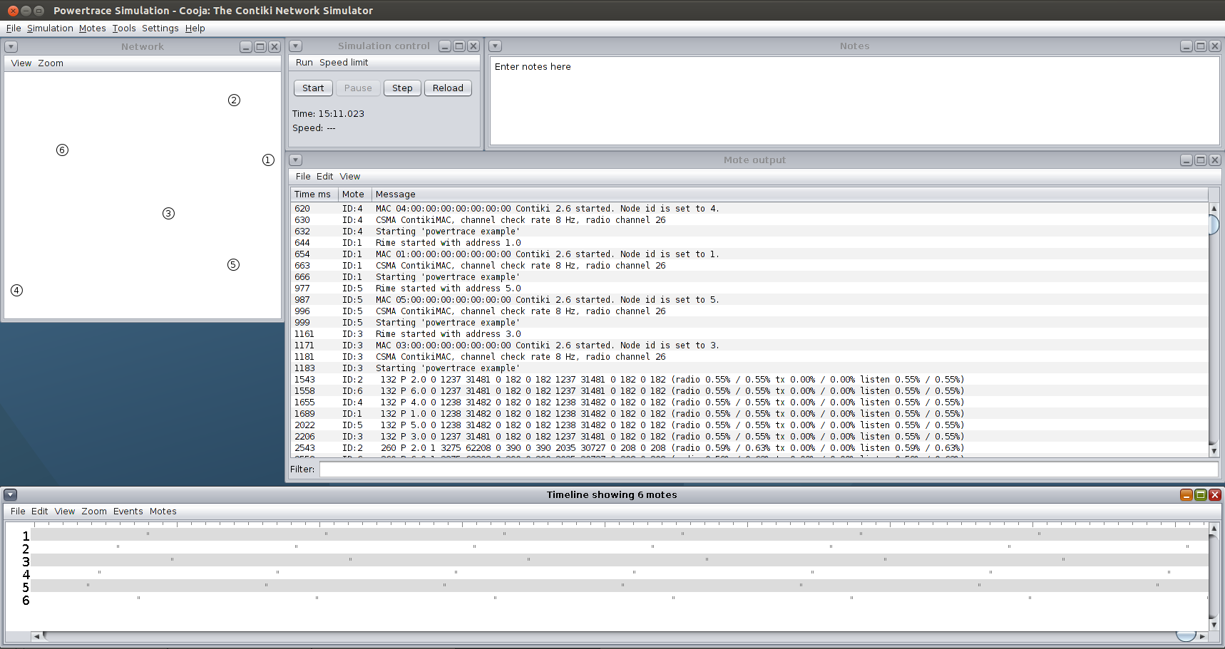
Cooja Simulator
Specialized for simulating Contiki OS-based IoT and WSN systems
Cooja Key Features
Integration with Contiki OS
Network Layer Emulation
Plugin System
Community and Resources

Slide 7
Comparison: CupCarbon vs. Cooja
Platform and Protocol Support
User Interface and Usability
Community and Documentation

Slide 8
Comparison: CupCarbon vs. Cooja
Characteristic | Cooja Simulator | CupCarbon
Primary Focus | Cooja serves as a simulation platform primarily aimed at modeling wireless sensor networks (WSNs), particularly those involving Internet of Things (IoT) devices and low-power sensor nodes. | CupCarbon is also a simulator designed for wireless sensor networks, but it is specifically tailored for vehicular networks and cyber-physical systems (CPS).
Focus Areas | It concentrates on simulating various aspects of WSNs, including communication protocols, energy consumption patterns, and application behaviors, with a specific emphasis on resource-constrained network environments. | Its primary focus lies in simulating vehicular mobility, communication scenarios within vehicular networks, and environmental monitoring, making it particularly suitable for applications related to vehicles and transportation systems.
Key Features | Supports simulation of various wireless communication protocols commonly utilized in WSNs, including IEEE 802.15.4, Zigbee, and 6LoWPAN. ii. Energy Consumption: Offers features for modeling and evaluating the energy consumption patterns of sensor nodes. iii. Topology Control: Enables the creation and analysis of different network topologies, including static and mobile sensor nodes. | realistic models for simulating vehicular mobility, incorporating factors such as vehicle movement patterns, road traffic dynamics, and traffic flow behaviors. ii. Communication Models: Tailored communication models account for vehicular network characteristics like vehicle speed, distance-based communication range, and network handovers. iii. Environment Simulation: Includes features for simulating environmental conditions relevant to vehicular networks, such as road conditions, weather variations, and terrain attributes.
Integration and Compatibility | Seamlessly integrates with the Contiki operating system, enabling researchers to develop and test IoT applications using Contiki's APIs and libraries. | integration capabilities with external tools and libraries specialized in simulating vehicular environments, traffic patterns, and geographic information systems

Slide 9
Conclusion
Choice depends on project requirements
CupCarbon's versatility vs. Cooja's specialization in Contiki OS
Considerations for operating system, geographical context, and specific protocols/technologies

Slide 10
References
References
https://youtu.be/OHHDE76F7Qc?si=m0-J7m8nu6tzk_An
https://github.com/bounceur/CupCarbon
http://www.oracle.com/technetwork/java/javase/downloads/jdk8-downloads-2133151.html
https://www.eclipse.org/
https://o7planning.org/fr/10619/installation-de-e-fx-clipse-sur-eclipse
http://gluonhq.com/products/scene-builder/
CS501 Slides by Dr. Mohammed Ayoub Alaoui Mhamdi https://moodle.ubishops.ca/course/view.php?id=4106

